Slide 1
Session 2
Task 1 Analysing the problem and designing the solution

Slide 2
Objectives
Students to create and apply a business context to a given scenario.
Students to understand the difference between functional and non functional requirements of the solution.
Students to identify a full list of problems that need to be solved to meet all the requirements.
Students to understand what are KPI (Key Performance Indicators)

Slide 3
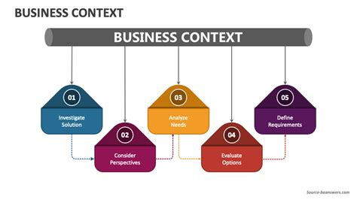
What is Business Context?
Please research what is meant by a business context.
Why is it important to identify the business context when designing a solution for a company?
Notes:
Business context refers to the internal and external factors that influence a company's decisions and strategies at a given time. This includes aspects like market conditions, competitive advantages, and technological changes that can impact the business.
https://3g.network/knowledgebase/what-is-the-context-of-business

Slide 4
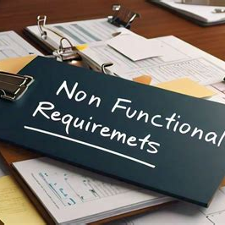
Functional and non functional requirements
What are functional and non functional requirements?

Slide 5
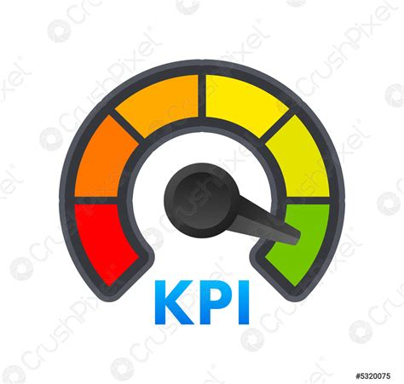
KPI’s (Key Performance Indicator)
What are KPI’s?
Why are these important to identify and use?

Slide 6

Bean and Brew Coffee Scenario
Please Read the scenario given and in pairs / or on your own answer the following questions:
What is the Business Context
The functional and Non functional requirements
A full list of problems that need to be solved to meet all the requirements
The KPI (Key performance Indicators)

